Slide 1

IT TICKET ANALYSIS
RAVI KANT MISHRA

Slide 2

Problem Statement
The objective is to analyze the IT support ticket management system to understand the performance of IT agents, the efficiency of ticket resolution, and the satisfaction levels of employees. The analysis aims to identify high and low performers among IT agents, assess the overall effectiveness of the team, and pinpoint areas for improvement in the ticket resolution process. The ultimate goal is to make informed staffing decisions, including hiring, firing, and training, to enhance overall service quality and team performance.

Slide 3
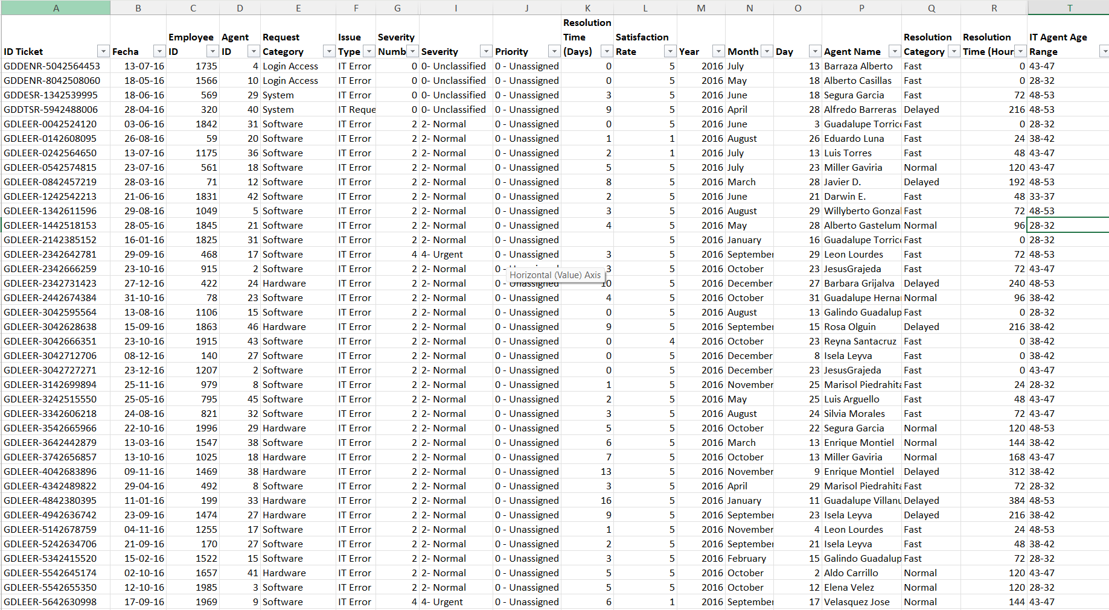
Tickets Sheet Data

Slide 4
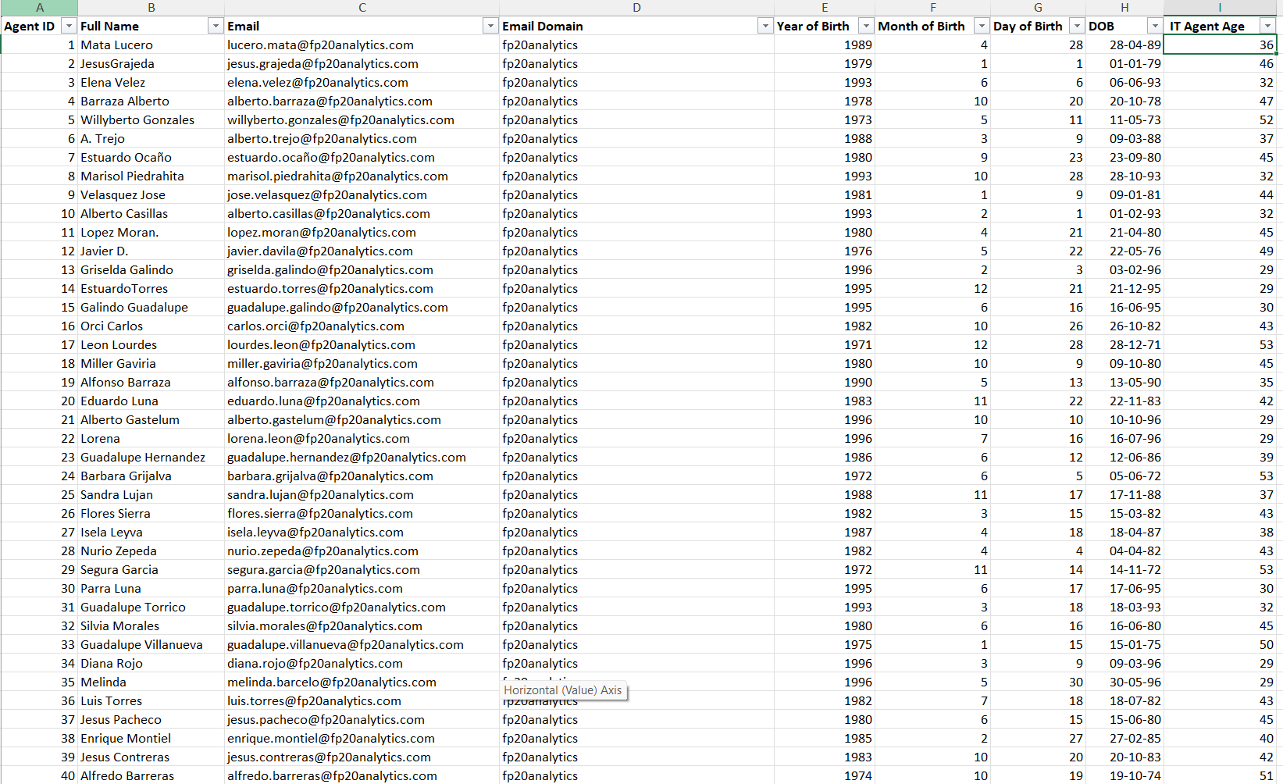
IT Agents Sheet Data

Slide 5
Data Attributes
IT Agents: Contains information about IT agents.
Agent ID: Unique identifier for the agent.
Full Name: Full name of the agent.
Email: Email address of the agent.
Year of Birth: Year the agent was born.
Month of Birth: Month the agent was born.
Day of Birth: Day the agent was born.
Tickets Sheet: Contains information about IT support tickets.
ID Ticket: Unique identifier for the ticket.
Fecha: Date of the ticket.
Employee ID: ID of the employee who raised the ticket.
Agent ID: ID of the agent assigned to the ticket.
Request Category: Category of the request (e.g., Login Access, System, Software).
Issue Type: Type of issue (e.g., IT Error, IT Request).
Severity: Severity of the issue.
Priority: Priority level of the issue.
Resolution Time (Days): Time taken to resolve the ticket.
Satisfaction Rate: Satisfaction rate provided by the employee (1-5 scale).

Slide 6
Data Overview
97,498 tickets in 5 years.
Number of Request Categories: 4
Unique Categories: Login Access, System, Software, Hardware
Number of Priorities: 4
Unique Priorities: Unassigned, High, Mid, Low.
Number of Agents: 50 agents
Number of Severities: 5
Unique Severities: Unclassified, Normal, Urgent, Major, Minor.
Data Cleaning and Preprocessing:
Fixed spelling mistakes in Priority and Severity.
Extracted the category from Priority and Severity.
Added agent details with tickets
Create a feature to group agents based on there Age.
Extracted the age of each agent.
Extracted domain name from agent email address.

Slide 7

Data Analytical approach and tools
Data Cleaning: Utilized functions TRIM,CLEAN,LEN,FIND,LEFT,RIGHT,ROUND.
Data Enrichment: Enhanced data set with additional variables using VLOOKUP to cross- reference external data source.
Trend analysis: Conducted time series analysis using PIVOT TABLE and Charts to find trend in tickets and its behavior.
Utilized DATE,DATEDIF to create feature columns in dataset.
Visualization: Created dynamic charts and dashboard for data representation, enabling interactive data exploration.
Filtering : Utilized Pivot table and Slicers feature to visualize and chronological filtering of data.
Conducted Cost Benefit Analysis for investment decision making.
Trend Analysis: Conducted time series analysis using line Chart.

Slide 8
Tickets Volume Over Time
Ticket volume increased steadily from 2016 to 2020, more than doubling overall.
2020 recorded the highest volume, indicating peak demand and workload.
Year-on-year growth accelerated after 2018, showing rising system usage.
The trend reflects consistent escalation in IT support demand over time

Slide 9
Satisfaction Rate and Resolution Time by Year
Customer satisfaction has consistently improved year-over-year from 2016 to 2020.
The highest satisfaction score was achieved in 2020 (4.16), reflecting improved service delivery.
Resolution time remained stable across all years, averaging around 4.5 days.
Improvement in satisfaction despite stable resolution time indicates better quality of support and communication.
Overall performance reflects a positive customer experience trend over time.

Slide 10
Age Group by Satisfaction Rate Based on Request Category
Customer satisfaction is consistently high, around 4.00 to 4.20 for tickets handled by all IT agent age groups. This is a strong positive signal.
The 28-32 age group of agents achieves the highest average satisfaction rate, 4.21.
The 33-37 and 43-47 age groups of agents show slightly lower overall satisfaction scores compared to others.
The 33-37 age group of agents, who have longer System and Software resolution times, also have a slightly lower satisfaction rate. This suggests that longer wait times, even if eventually resolved, can subtly impact satisfaction.

Slide 11
Average Resolution Time by Request Category
Hardware issues take the longest to resolve, 7.63 days.
System issues average 6.62 days.
Software requests average 5.24 days.
Login Access requests are resolved very quickly (0.31 days).
Hardware resolution is a systemic issue affecting all agent age groups.

Slide 12
Monthly Distribution of Tickets by Total Resolution Time
It is clear from the above chart that more tickets are resolved in the months of August, October, and December.
January is the month with the lowest volume of tickets being resolved.
There might be fewer unresolved or overdue tickets in Jan.
Higher delays and dissatisfactions.
Indicates insufficient resources and inadequate training.

Slide 13
Distribution of Tickets by Satisfaction Score
More than 80% tickets have high satisfaction scores (4 & 5), showing strong service quality; maintain current support processes and SLAs.
Over 50% tickets rated 5, indicating excellent customer experience; recognize and replicate best-performing agent practices.
Very low dissatisfaction (Score 1–2 ~3%), suggesting minimal service gaps; analyze these cases to prevent repeat issues.
7% tickets rated 3 reflect neutral experience; focus on faster resolution and clearer communication to improve ratings.
Overall satisfaction trend is positive; target conversion of Score-3 users into Score-4/5 through proactive follow-ups.

Slide 14
Recommendation
Invest in automation & self-service for high-volume requests (System, Login Access).
Strengthen IT Asset Management, spare inventory & vendor SLAs for Hardware support.
Deploy advanced diagnostics tools & robust knowledge base for System & Software.
Upgrade Ticket Management system for better routing, workload balancing & scalability.
Prioritize reducing resolution time for System & Hardware tickets.
Introduce specialized technical training & knowledge base expansion.
Implement priority-based ticket routing, assigning complex cases to senior agents.
Streamline Login Access handling through automation due to high volume.
Monitor Software tickets closely to prevent future escalation.
Short-to-Medium Term: Improve training programs for faster resolution & higher customer satisfaction.
Medium-to-Long Term: Upgrade ticketing platform to support growth & reduce incoming demand.
Encourage high-performing agents (28-32, 43-47) to document solutions.
Utilize senior agents (48-53) for mentorship & complex tickets.
Provide targeted training:
Customer service & communication for low-satisfaction agents.
Advanced troubleshooting for agents with long resolution times.
Focused System & Software training for 33-37 age group

Slide 15
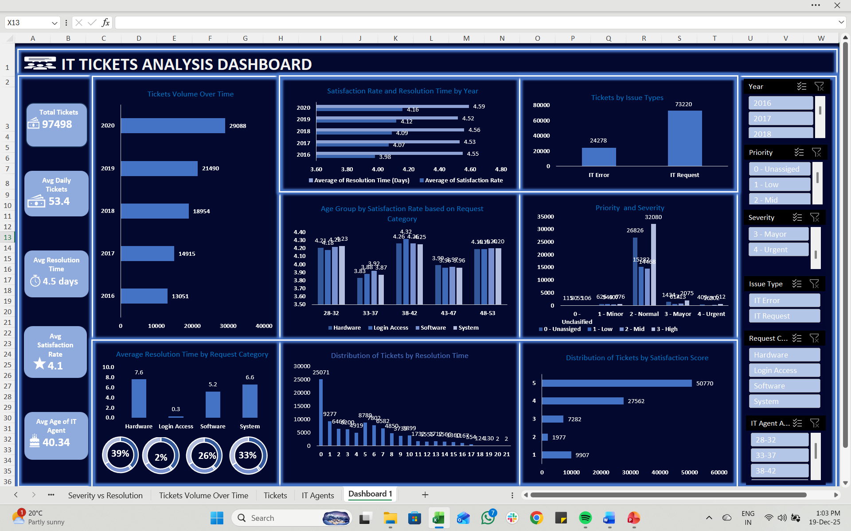

Slide 16
Conclusion
This analysis provides a clear roadmap to transform a growing but reactive IT support function into a proactive, efficient, and scalable operation. By strategically investing in our people and technology, we can sustain high customer satisfaction while successfully meeting the future demands of our organization.
The IT support team is facing a challenge of ever-increasing ticket volume, but has successfully maintained high customer satisfaction. The current system is inefficient, with issues like unassigned priorities. The most effective short-term solution is to invest in training to empower agents and reduce resolution times. For long-term sustainability, a strategic upgrade of the ticket management software is essential to proactively reduce demand and ensure a scalable operation.

